Slide 1
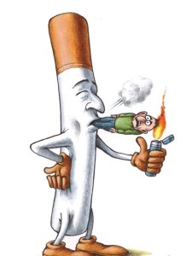
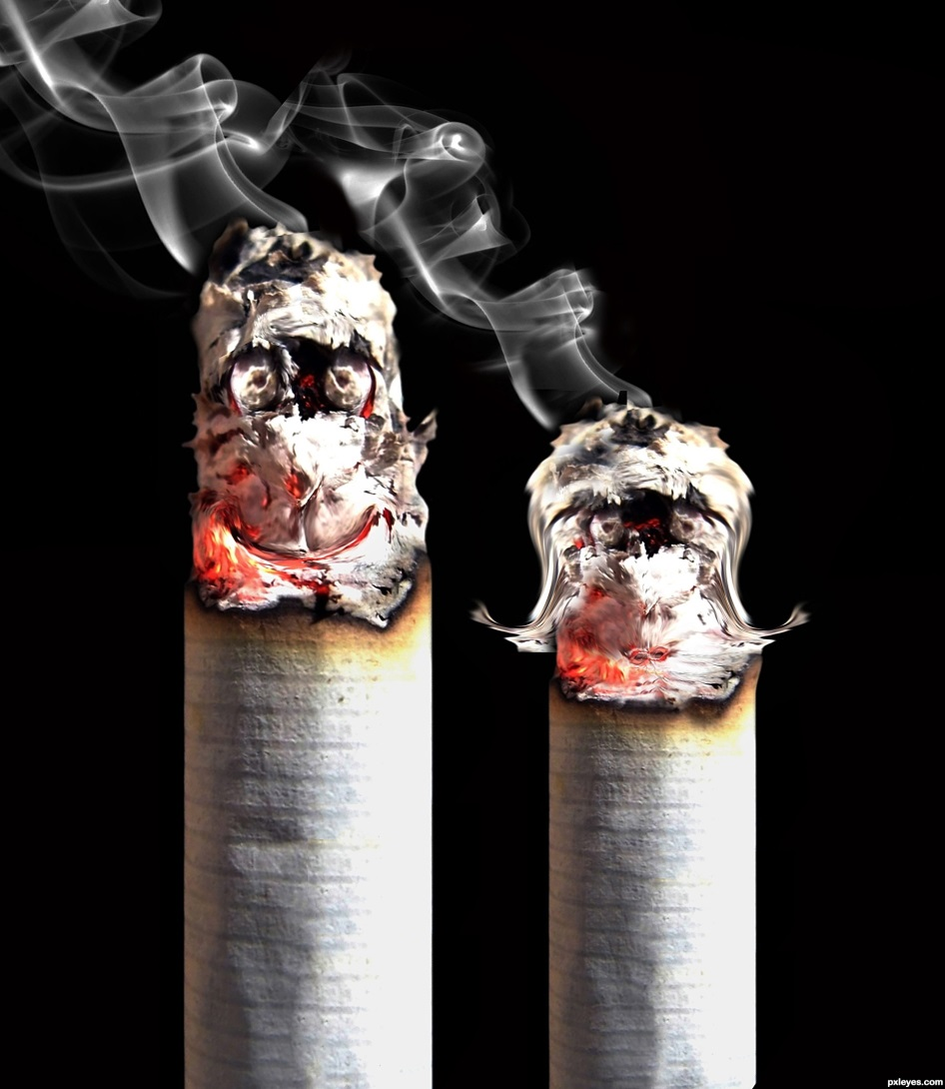
Smoking

Slide 2
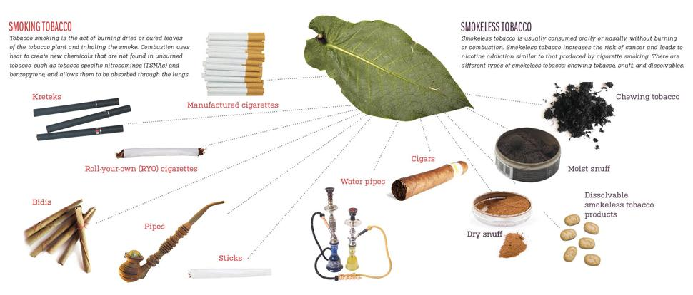
How Tobacco Is Used

Slide 3
-The 1982 Surgeon General's Report stated that "Cigarette smoking is the major single cause of cancer mortality in the United States." This statement is as true today as it was in 1982. -Smoking is responsible for nearly 1 in 5 deaths in the United States. Because cigarette smoking and tobacco use are acquired behaviors -- activities that individuals choose to do -- smoking is the most preventable cause of premature death in our society
Cigarette Smoking
The numbers were higher in younger age groups. Almost 24% of those 18 to 44 years old were current smokers, compared to less than 9% in those aged 65 or older.

Slide 4
ANATOMY OF CIGARETTE
Carbon Monoxide car exhaust
Nicotine pesticide
Ammonia floor cleaner
Arsenic white ant poison
Butane lighter fluid
Hydrogen Cyanide poison used in gas chambers
DDT insecticide
Acetone paint stripper
Cadmium car batteries
Methanol rocket fuel
Formaldehyde preservative for dead bodies
Hydrazine rocket fuel
Naphthalene moth balls
Tar
Red = main ingredients

Slide 5
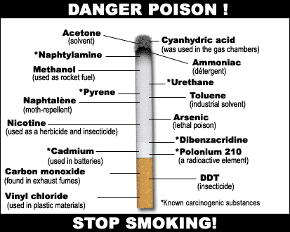

Slide 6
Smoke…
Mainstream Smoke: Smoke a smoker inhales and exhales
Sidestream Smoke: Smoke that goes into the air from a cigarette
Passive Smoke: Secondhand smoke, a nonsmoker inhales

Slide 7
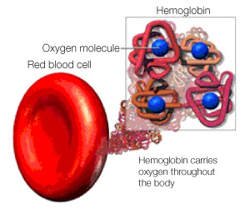
How Carbon Monoxide Enters Body
Carbon monoxide binds to the hemoglobin (in red blood cells). Hemoglobin carries oxygen through body.
Carbon monoxide takes place of the oxygen (less oxygen in red blood cells)
Less oxygen gets transported to body tissues and organs making the body not function correctly

Slide 8
Nicotine Addiction
In 1988, the US Surgeon General concluded the following:
Cigarettes and other forms of tobacco are addicting.
Nicotine is the drug in tobacco that causes addiction.
The pharmacologic and behavioral processes that determine tobacco addiction are similar to those that determine addiction to drugs such as heroin and cocaine.

Slide 9
What causes nicotine addiction?
Nicotine is an addictive drug. It causes changes in the brain that make people want to use it more and more
Addictive drugs cause unpleasant withdrawal symptoms
The good feelings that result when an addictive drug is present — and the bad feelings when it's absent — make breaking any addiction very difficult. Nicotine addiction has historically been one of the hardest addictions to break.

Slide 10
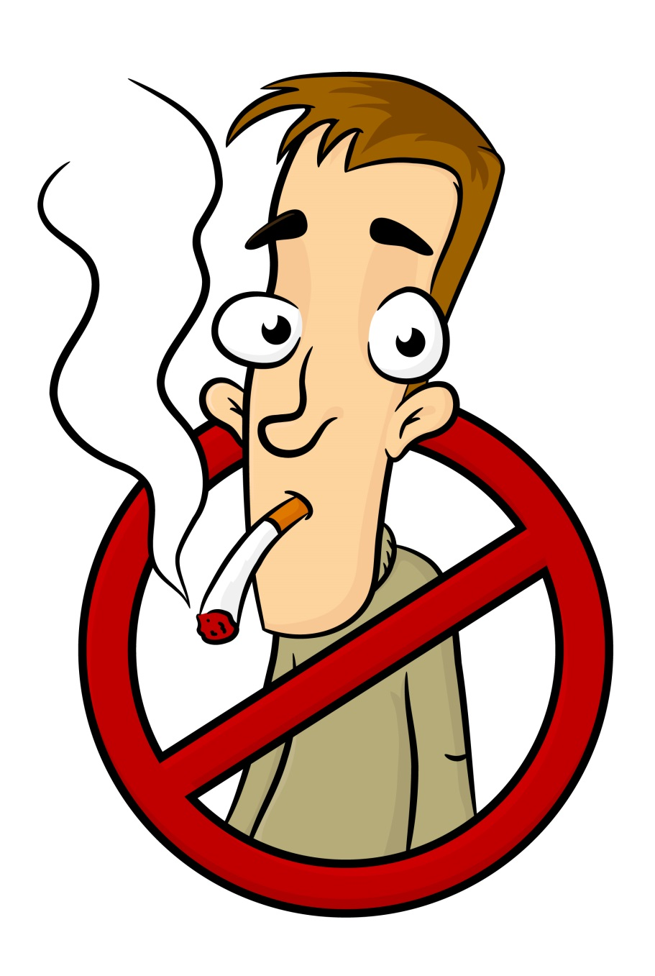
Nicotine Addiction: WHY EVEN START?
Although 70% of smokers want to quit and 35% attempt to quit each year, less than 5% succeed.
The low rate of successful quitting and the high rate of relapse are related to the effect of nicotine addiction.

Slide 11
Why do people start?
Young people start because:
Peer pressure
Energetic
Feel older
Like how it looks
Addicted
Curiosity
Model celebrities
Parents
Something to do
Relax
It is what they know/ who they are around

Slide 12
What else does nicotine do to the body?
When a person smokes a cigarette, the body responds immediately to the chemical nicotine in the smoke.
Nicotine causes
Short-term increase in blood pressure
Heart rate and the flow of blood from the heart
Arteries to narrow
The smoke includes carbon monoxide, which reduces the amount of oxygen the blood can carry. This, combined with the nicotine effects, creates an imbalance between the demand for oxygen by the cells and the amount of oxygen the blood can supply.

Slide 13
Facts on Youth Smoking, Health, and Performance
Smoking is associated with poor overall health and a variety of short-term adverse health effects in young people and may also be a marker for underlying mental health problems, such as depression, among adolescents. High school seniors who are regular smokers and began smoking by grade nine are:
2.4 times more likely than their nonsmoking peers to report poorer overall health
2.4 to 2.7 times more likely to report cough with phlegm or blood, shortness of breath when not exercising, and wheezing or gasping
3.0 times more likely to have seen a doctor or other health professional for an emotional or psychological complaint.

Slide 14
Health Effects of Smoking
About half of all Americans who continue to smoke will die because of the habit. Each year about 440,000 people die in the United States from illnesses related to cigarette smoking.
Cigarettes kill more Americans than alcohol, car accidents, suicide, AIDS, homicide, and illegal drugs combined.
Smoking is the major single cause of cancer deaths in the US

Slide 15
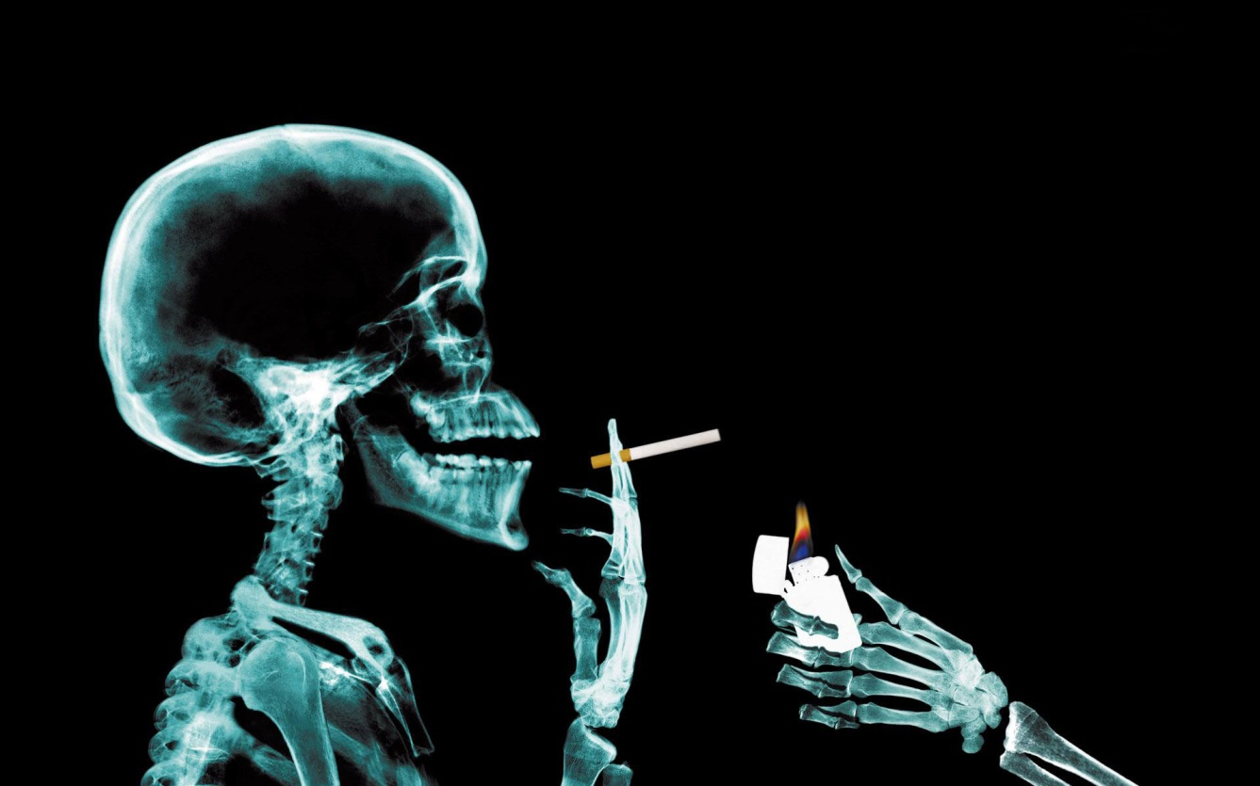
Effects on Quantity and Quality of Life
Based on data collected from 1995 to 1999, the CDC estimated that adult male smokers lost an average of 13 years of life and female smokers lost 14.5 years of life because of smoking.

Slide 16
Are You Addicted?
If you answer "Yes" to any of the questions below, your body has become addicted to nicotine.
The craving for a cigarette is especially strong first thing in the morning.
You begin to feel a craving for nicotine within 30 minutes to an hour after your last cigarette.
Even when you're sick you still crave cigarettes.
When you can't smoke, you think about smoking and plan when you can smoke again.
You experience withdrawal symptoms when you quit smoking. You may also experience anxiety, stress, or even depression.

Slide 17
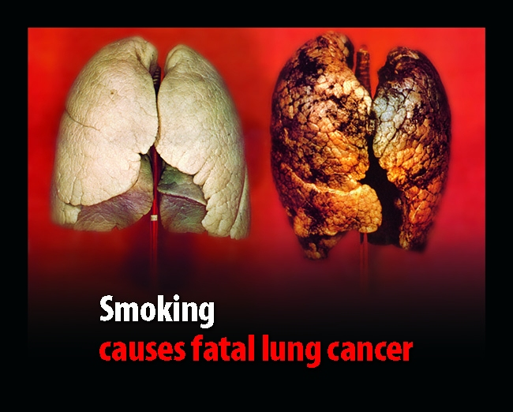
Why You Should Quit
Smoking causes 87% of all lung cancer cases and most cases of emphysema and chronic bronchitis.

Slide 18
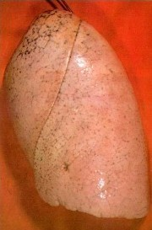
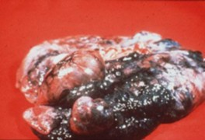
Lung Damage
Normal lung with some damage from pollution
Smoker’s Lung

Slide 19
What Else?
Smoking also causes:
Mouth cancer
Throat cancer
Bladder cancer
Emphysema
Stroke
Heart attack
Chronic bronchitis
Gastric ulcers
Emphysema= Holes in lung
Destroys elasticity of air sacs

Slide 20
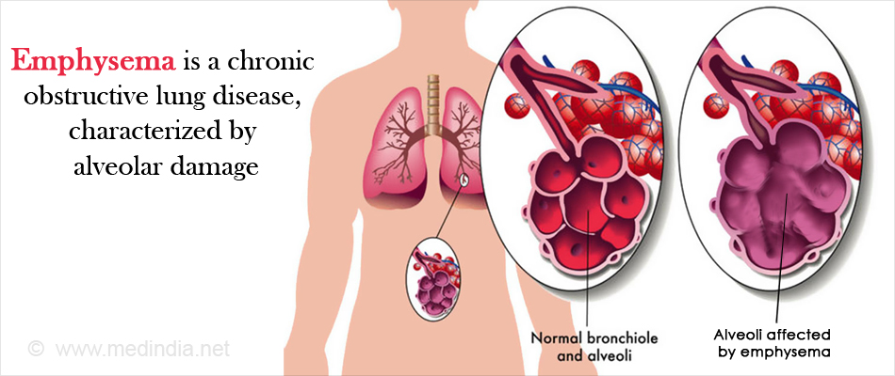
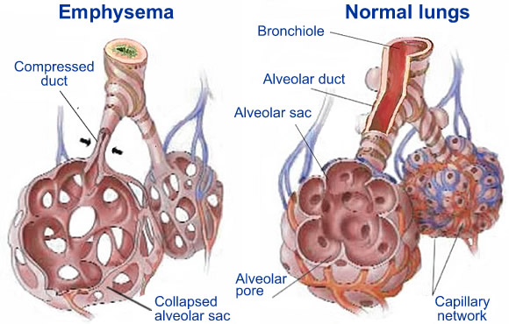

Slide 21
Smoking While Pregnant?
Babies of mothers who smoke while pregnant:
Low birth weight
Premature
Miscarriage
Respiratory problems
Mental health problems

Slide 22
How Do Companies Attract Smokers?
-Target what's popular -Use celebrities
-Make it look cool -Make flavors
-Use false data

Slide 23
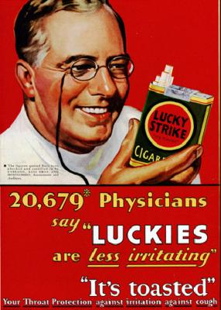

Slide 24
E-Cigarettes
The new trend...
http://www.drugabuse.gov/related-topics/trends-statistics/infographics/monitoring-future-2014-survey-results
http://www.drugabuse.gov/related-topics/trends-statistics/infographics/e-cigarettes-facts

Slide 25
Marijuana?
Smoking marijuana can cause changes in lung tissue that may promote cancer, according to a review of decades of research on marijuana smoking and lung cancer.
Analyses of sputum and lung tissue performed in some of these studies found more cancer-promoting changes in pot smokers than in cigarette smokers or non-smokers.

