Slide 1
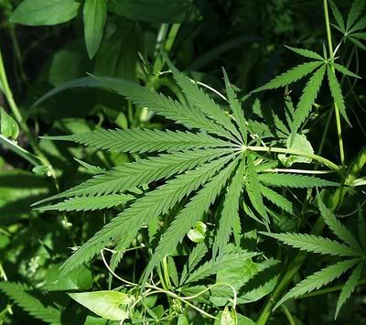
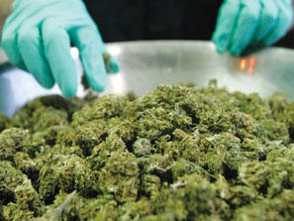
Cannabis aka
Marijuana

Slide 2
Pre Test Answers
Check and see how smart you already are!

Slide 3
1. More than ___ percent of teens in drug treatment are there due to their dependence upon marijuana.
C
65 %

Slide 4
2. ______ or THC is the powerful chemical in marijuana responsible for a user’s high.
B
Tetrahydrocannabinol

Slide 5
3. In the brain, THC affects a great number of brain cells except for:
A
The receptors that sense pain

Slide 6
4. THC:
A
Hijacks the pleasure center of the brain

Slide 7
5. People who smoke marijuana are inhaling ____ times as much tar and carbon monoxide as cigarette smokers.
C
Three to five times

Slide 8
6. In the past 20 years, the amount of THC in marijuana has:
D
Risen by more than 200 %

Slide 9
7. More than _____ different chemicals enter the body when a person smokes marijuana.
C
400

Slide 10
8. Research has proven that, over time, marijuana can cause the user:
A
To have an increased risk of mental problems such as clinical depression, attention deficit disorder, and schizophrenia

Slide 11
Marijuana Nicknames/ Slang
Pot
Herb
Ganja
Weed
Buddha
Doobie
Bud
Mary Jane
Grass
Reefer
Dank
Chronic
Dro
Haze
Headies
Sticky Icky
Northern Lights
Green
420
Dope

Slide 12
Why are some of the names misleading?
Buddha: the name implies enlightenment or spirituality
Herb, Grass, Green: these names sound natural and not the least bit harmful
Northern Lights: this term implies a beautiful visual experience
Mary Jane: this name suggests innocence

Slide 13
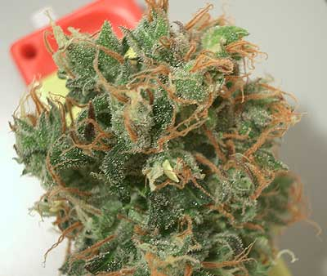
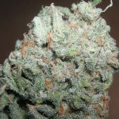
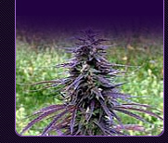
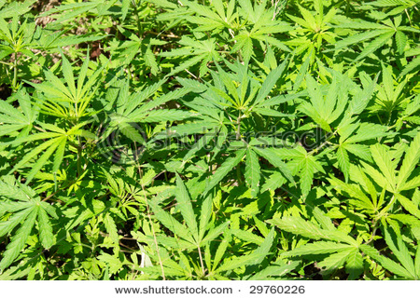
What is Marijuana?
Marijuana is one of the most commonly used drugs today
Made from the dried leaves and flowers of the hemp plant (Cannabis sativa)
Hemp leaves are usually green, brown, or gray in color, but can vary depending on the type of hemp
It affects the user’s mind and behavior: often feel more relaxed and cheerful
Often referred to as a “gateway” drug

Slide 14
What’s in Marijuana?
Delta-9-tetrahydrocannabinol (THC) is the most common ingredient
More than 400 chemicals found in marijuana
Effects depend on the amount of THC
Today’s marijuana contains an average of 5% THC, making it far more potent and dangerous than the marijuana of the 1960s and 70s which contained less than 2% THC

Slide 15

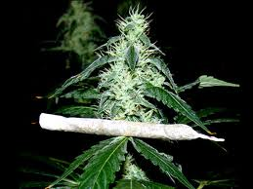
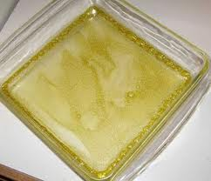
Other Forms With MORE THC
Sinsemilla: made from unpollinated female hemp plants contain about 12% THC
Hashish (hash): come from flowers of female hemp plant contains about 6% THC
Hash oil: tar-like liquid produced by soaking marijuana plant in chemical solvent contains about 15% THC

Slide 16
How does it affect the body?
WHEN SMOKED: enters the lungs through the windpipe and bronchial tubes. In lungs, smoke particles travel into tiny air sacs, where THC molecules enter the blood
WHEN EATEN: chemicals absorbed by the small intestine, where they enter the bloodstream
THC interferes with normal functioning of the cerebellum, part of the brain that controls balance and coordination
Reflexes are often dulled
THC affects the hippocampus, part of brain dedicated to memory and recall, resulting in short-term memory problems
Causes the brain to misinterpret nerve impulses from the sensory organs, changing the way a person experiences sight, sound, touch, smell, and taste.

Slide 17
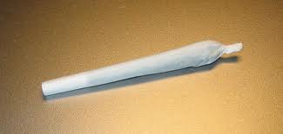
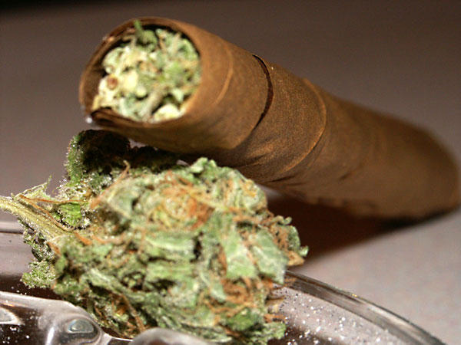
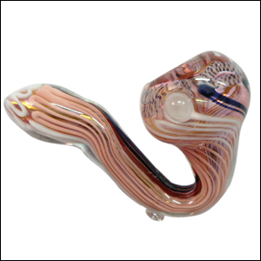
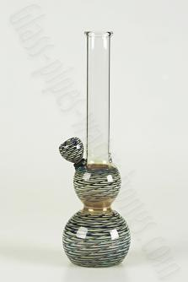
How is marijuana used?
Joint/Roach: loose marijuana is rolled in a cigarette and smoked. A roach is a joint that has been smoked almost completely
Blunt: hallowed-out commercial cigar in which the tobacco has been replaced with marijuana
Pipe, bowl, bong: smokes using special pipes, ranging in design from simple, tobacco-smoking pipes, to more complex, multi-chamber water pipes

Slide 18
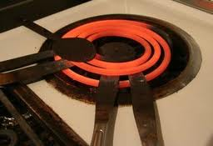
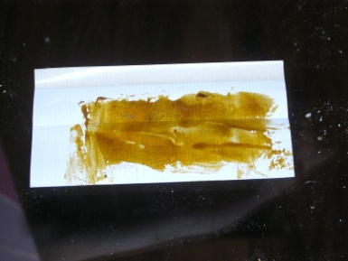
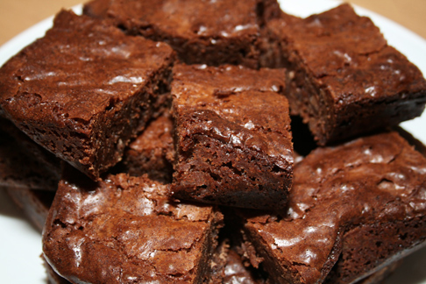
How is marijuana used? Cont.
Hot knives: knives are sometimes used to heat marijuana buds, yielding a potent smoke that can be inhaled
Hash oil: may be applied to joints or to ordinary cigarettes
Food: users occasionally mix with food, such as brownies or cakes, or used to brew tea

Slide 19
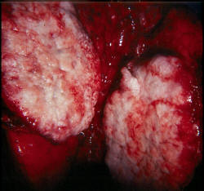
Lung Damage
Marijuana smokers inhale harmful carcinogens with every puff
May deliver as much as five times the amount of tar and carbon monoxide than found in cigarettes
Can severely damage lungs and pulmonary system. Eventually can destroy lung tissue
Regular users are more prone to lung infections and often suffer from chronic coughs, chest colds, emphysema, bronchitis, and bronchial asthma.
Increased risk of lung cancer.

Slide 20

Heart & Blood Pressure Changes
Marijuana can increase heart rate and raise blood pressure
When used in combination with other drugs, the effects of marijuana are intensified
A person who uses cocaine and marijuana together may increase pulse rate by almost 50 beats per minute.
Marijuana can increase risk of heart disease and stroke.

Slide 21
Brain Damage & Immune System
Marijuana is chemically fat-soluble, so the brain easily absorbs and stores the chemicals released by marijuana.
Will effect impaired concentration, learning difficulty, and memory loss
Can cause structural damage to parts of the brain associated with learning and memory
By interfering with helper T cells, which aid the immune system in identifying, attacking, and destroying invading bacteria and viruses.

Slide 22
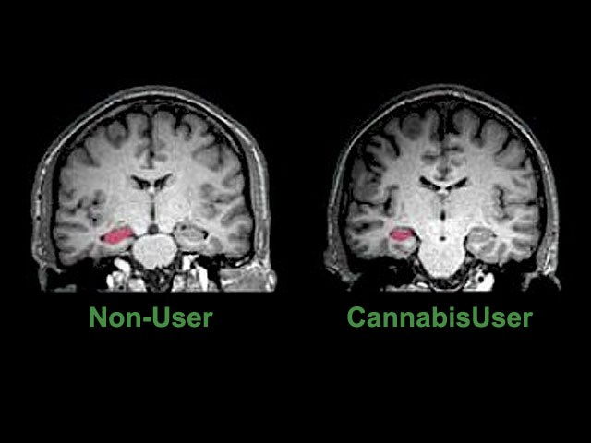

Slide 23
Damage to Reproductive Systems
MALES
FEMALES
Effects hormone levels
Decrease testosterone
Reduce sex drive
Inability to grow facial hair
Poor muscle development
Smaller overall size
Inability to father children
Decreased sperm count
Disrupt normal menstrual cycles
Interfere with ovulation
Increases testosterone levels, which leads to dark body hair, facial hair, and acne

Slide 24
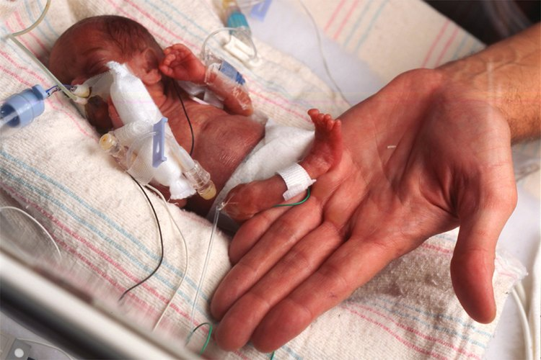
Damage to Fetuses & Infants
Can keep the fetus from getting all of the oxygen that it needs
Babies have increased risk for health problems
Lower birth weight
Smaller head size
Smaller overall size
Birth defects
Fetal growth deficiencies
Nervous system damage
Miscarriage

Slide 25
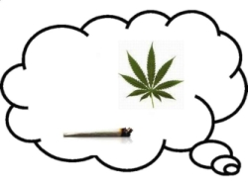
Marijuana Dependence
Physiologically dependent: must continue use to avoid experiencing withdrawal symptoms
Psychologically dependent: compulsively seeks out and uses a drug, though they may not suffer physical symptoms when use is discontinued
Marijuana users may become PSYCHOLOGICALLY dependent, not physiologically addicted

Slide 26
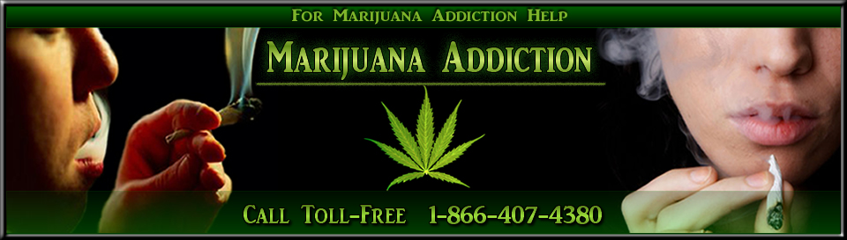
Signs of Marijuana Use
Difficulty remembering recent events
Overly sensitive or bloodshot eyes
Use of eye drops, use of sunglasses at inappropriate times
Dizziness or impaired motor coordination
Distinct smell on clothing
Presence of drug paraphernalia (pipes, rolling papers, etc.)
Observable changes in appearance or behavior
Decreased levels of performance
Moodiness, paranoia, or fearfulness

Slide 27
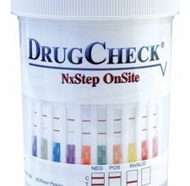
Marijuana Use & The Workplace
A number of businesses and companies now require employees to pass drug tests before they are hired
Drug test can trace THC for several weeks after marijuana use
Marijuana users can lose their jobs, be subject to suspension or disciplinary action, damage future advancement or employment opportunities, and acquire a criminal record

Slide 28
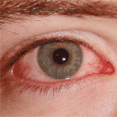
Short-Term Effects
Increased appetite
Distorted perception of reality
Bloodshot eyes
Dry mouth and throat
Difficulty keeping track of time
Impaired short-term memory
Paranoia and anxiety
Unable to perform tasks requiring concentration
Undependable and irresponsible behavior
Loss of physical and mental motivation

Slide 29
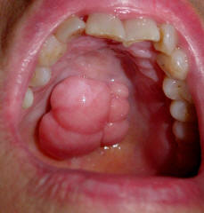
Long-Term Effects
Greater risk of head and throat cancer
Decrease in testosterone levels for men
Decreased fertility in men
Increase in testosterone levels for women
Psychological dependence requiring more of the drug to get the same effect
Weight gain due to increased appetite
Body’s immune system is weakened
Possible increased risk of depression or other mental illness

Slide 30
Facts
Marijuana smoke contains 20 times more of the toxic compound ammonia than tobacco smoke.
Marijuana interferes with the messages going to your brain and alters your perceptions, emotions, vision, hearing, and coordination.
After alcohol, marijuana is the second most frequently detected substance among drivers in traffic arrests and vehicular fatalities.
A person may inhale three times the amount of tar when smoking a marijuana cigarette than when smoking a tobacco cigarette.

Slide 31
Facts cont.
In 49 states, it is illegal to use, buy, sell, or carry marijuana. (exception medical)
In 1960, an average marijuana joint contained less than one percent of THC. Today, the level of THC in an average joint is around nine percent, but can be as high as 30%.
More THC means more side effects for users– side effects such as impaired brain responses, fatigue, loss of motivation, and decreased memory function.

Slide 32
Facts one more time
A single marijuana joint may contain as much lung cancer causing material as a pack of tobacco cigarettes.
Compared to nonsmokers, long-term marijuana smokers have a much greater rate of pre-cancerous cell changes.
THC, the main ingredient in marijuana, has been shown to lower the body’s ability to fight diseases and cancerous tumors.

Slide 33
Marijuana behind the wheel…
According to the National Highway Traffic Safety Administration, approximately 14% of fatally injured drivers in car crashes have marijuana in their blood.
According to the 2007 National Survey on Drug Use and Health, 9.9 million people age 12 and older reported driving under the influence of illicit drugs, including marijuana, in the past year.
NIDA’s 2006 Monitoring the Future survey indicated that 23% of HS seniors admitted to driving under the influence of marijuana or riding with a driver who had smokes marijuana in the 2 weeks prior.

Slide 34
Marijuana behind the wheel…
In 2001, an estimated 38,000 HS seniors in the US reported that they had been the driver in a car crash while under the influence of marijuana.
In 2007, marijuana was the commonly used illicit drug.
Marijuana use impairs driving performance, including decreased car handling ability, impaired time and distance estimation, subjective sleepiness, and lack of motor coordination, for up to 3 hours.

Slide 35
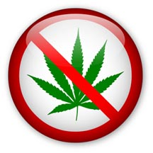
Keeping Away From Marijuana
Respect yourself and treat yourself well– remember you don’t need marijuana
Stay away from people who use or sell marijuana; don’t put yourself in awkward situations
Avoid places where you think marijuana will be available; don’t go to parties, concerts, or gatherings where you know drug abuse will occur
Associate with drug-free, like-minded friends and co-workers. Encourage your friends to avoid drugs, and rely on them as a support group to keep you out of harmful situations

Slide 36

Getting HELP
First and most difficult step is admitting you have a problem and need help
Should seek professional help
Counselors, physicians, and healthcare providers can help
Phone directory contains numbers for national and local substance abuse hotlines, support groups, and mental health services

Slide 37
The CONTROVERSY
Raw marijuana is currently prohibited by federal law
Classified by the US department of Justice as a Schedule I controlled substance, meaning that it has no accepted medical use.
US Food and Drug Administration has, however, approved the use of synthetic THC capsules for treatment of nausea and appetite loss in cancer and AIDS patients
Some groups claim that marijuana produces no lasting harmful effects

Slide 38
RUMOR HAS IT: You can’t get busted for marijuana if you’re smoking it in the privacy of your own home.
THE TRUTH IS: You CAN get busted for marijuana if you’re smoking it in the privacy of your own home.

Slide 39
RUMOR HAS IT: If you get caught smoking pot at a friend’s house, he/she will be held legally responsible, not you.
THE TRUTH IS: YOU are still the person responsible.

Slide 40
RUMOR HAS IT: If you have been smoking marijuana, you can’t get arrested if you don’t have it in your possession when the police arrive.
THE TRUTH IS: If you have been smoking marijuana, you CAN STILL get arrested if you don’t have it in your possession when the police arrive.

Slide 41
RUMOR HAS IT: If you are convicted of drug possession as a minor, it will be erased from your permanent record when you turn 21.
THE TRUTH IS: If you are convicted of drug possession as a minor, it will NOT be erased from your permanent record when you turn 21.

Slide 42
RUMOR HAS IT: If you get caught smoking pot at your home, your parents cannot be legally punished.
THE TRUTH IS: If you get caught smoking pot at your home, your parents CAN be legally punished.

Slide 43
RUMOR HAS IT: You cannot be prosecuted if you are caught with paraphernalia such as a bong or pipe for smoking marijuana.
THE TRUTH IS: You CAN be prosecuted if you are caught with paraphernalia such as a bong or pipe for smoking marijuana.

Slide 44
Class Debates
Move to the side of the room you agree or disagree with. We will then debate and talk about both sides.

Slide 45
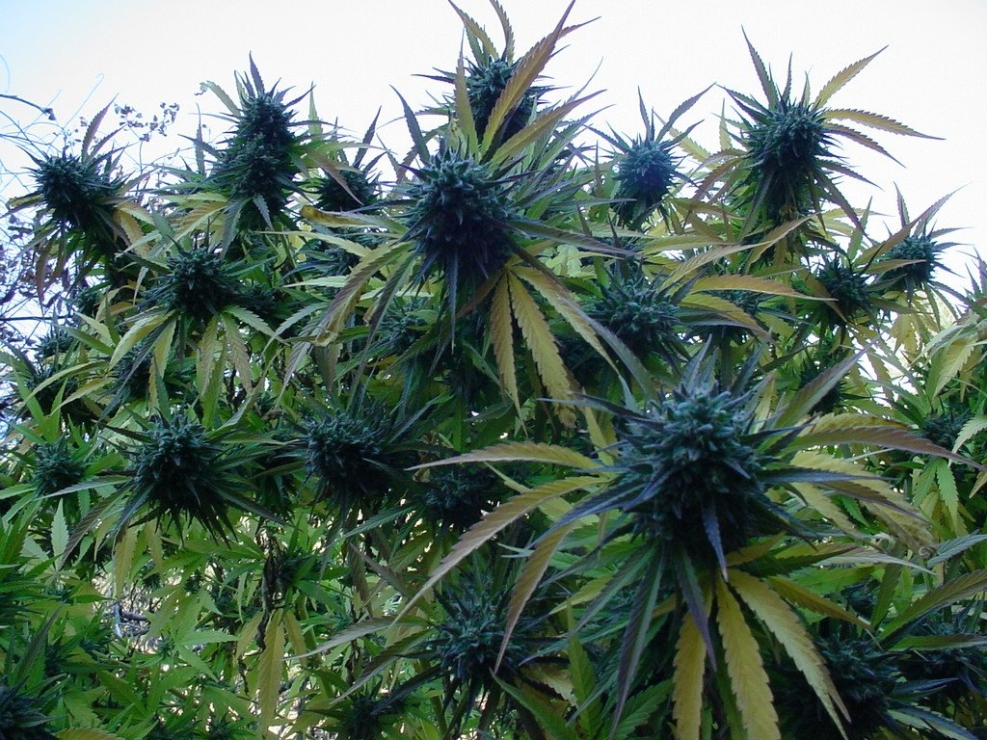
Marijuana should remain illegal.

Slide 46
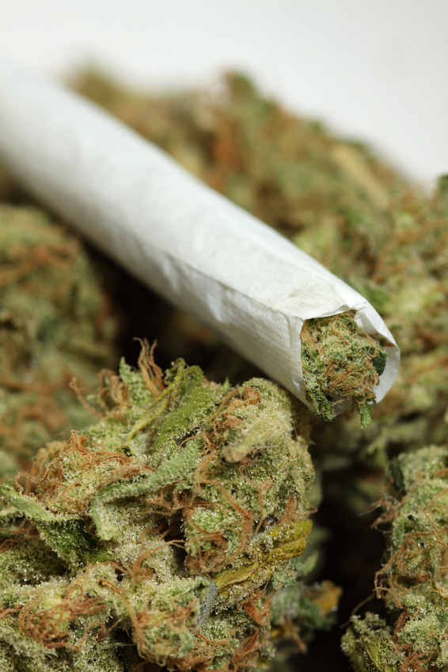
Marijuana’s reputation as a harmless drug makes it even more dangerous than some other illegal drugs.

Slide 47
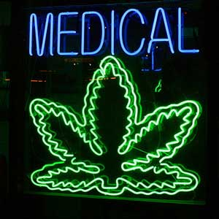
Scientific research concerning marijuana is usually biased by the researcher’s personal opinion about legalization.

